Slide 1
Life during the New Deal
The Main Idea
The Great Depression and the New Deal had a deep impact on American culture during the 1930s.

Slide 2
New Roles for Women
Women
Roosevelt promoted and recognized women.
Frances Perkins – Secretary of Labor – was the first woman to head an executive office.
Ruth Bryan Owen served as minister to Denmark.
Roosevelt appointed women to such posts as director of the U.S. Mint and assistant secretary of the Treasury.
Women served as leaders in several New Deal agencies.
Still, women faced challenges and discrimination.
Lower wages
Less opportunities
Hostility in the workplace

Slide 3
New Roles for African Americans
Roosevelt’s administration also appointed many African Americans.
William Hastie became the first black federal judge.
A group of African Americans hired to fill government posts were known as the Black Cabinet, and they served as unofficial advisors to the president.
The Black Cabinet met under the leadership of Mary McLeod Bethune, director of Negro Affairs in the National Youth Administration.
Still, African Americans continued to face tremendous hardships during the 1930s.
Severe discrimination
Thousands of African American sharecroppers and tenant farmers were not helped by New Deal programs.
Southern Democrats in Congress opposed efforts to aid African Americans.
Many African American switch from the Republican Party to the Democratic Party during the 1930s.

Slide 4
Art of the Great Depression
Painters and sculptors fashioned works depicting the struggles of the working class.
Authors and playwrights focused on the plight of the rural and urban poor.
Writer John Steinbeck’s The Grapes of Wrath
Songwriter Woody Guthrie celebrated the lives of ordinary people.
Writer James Agee’s Let Us Now Praise Famous Men
Photographers
Dorothea Lange recorded images of jobless people and the rural poor.
Walker Evans depicted the lives of sharecroppers in the Lower South.

Slide 5
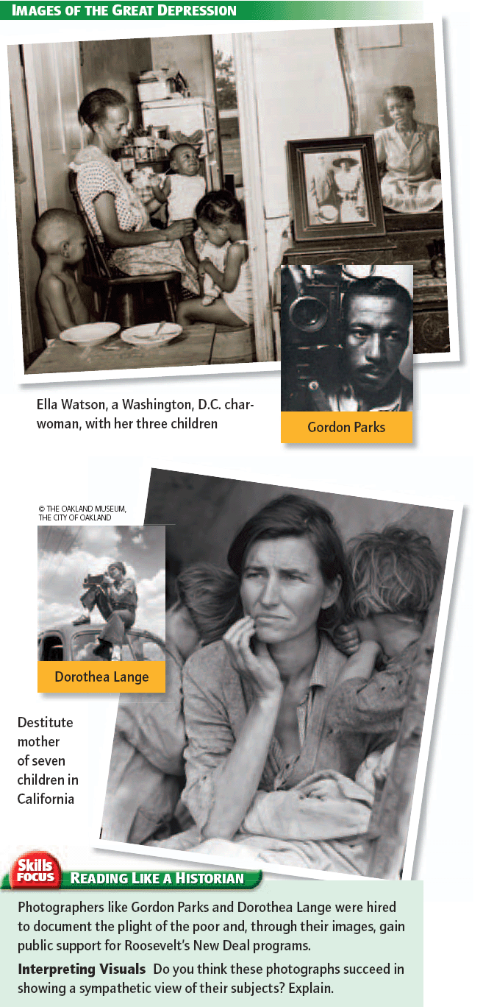
Dorothea Lange
Dorothea Lange was a celebrated chronicler of the Great Depression. She recorded images of jobless people in her hometown of San Francisco.
Lange worked for the Farm Security Administration. She was hired to document the plight of the poor and, through her images, gain public support for New Deal programs.
Lange’s photographs of the rural poor helped raise awareness about the poorest of the poor – sharecroppers and tenant farmers. In 1937 the federal government finally began to provide help to sharecroppers and tenant farmers.

Slide 6
Popular Entertainment of the Great Depression
Movies
Millions of Americans went to the movies each week.
Most films were upbeat and allowed viewers to “escape” the depression.
Grand musicals and comedies were popular.
Animation and color photography delighted audiences.
Radio
Provided politics, religion, music, sports, and other forms of entertainment
Introduced new music styles such as jazz and swing
Action shows such as The Lone Ranger and comedies such as Fibber McGee and Molly were popular.
Sports
Interest in sports remained strong in the 1930s.
Baseball was popular.
Babe Ruth
Joe DiMaggio
Boxing was hugely popular.
Joe Lewis

