Slide 1
New ideas in society

Slide 2
Rock, paper, scissors activity

Slide 3
New ideas on economics
Old system: Mercantile system, government restricted trade.
New Idea: Laissez-faire, government should not interfere in business.
Adam Smith: Supporter of Laissez-faire economics. Wrote book The Wealth of Nations
Thomas Malthus: wrote an essay on the principle of population, wealth factory owners used his theory to justify paying their employees low wages.

Slide 4
Capitalism
an economic system where trade, industry and the means of production are controlled by private owners with the goal of making profits in a market economy

Slide 5
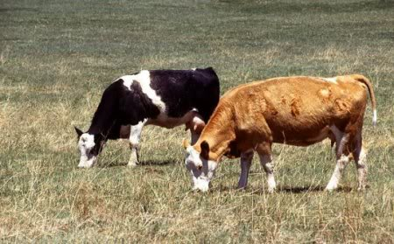
You Have Two Cows…..

Slide 6
Capitalism
CAPITALISM: You have two cows. You sell one and buy a bull.
CAPITALISM -- AMERICAN: You have two cows. You sell one of them, and buy a bull. The cow and bull have a great love life and make more cows. Now you have lots of cows and you’re rich!

Slide 7
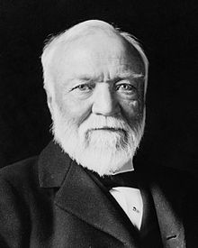
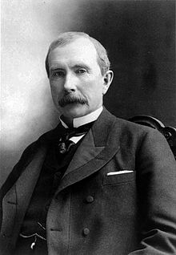
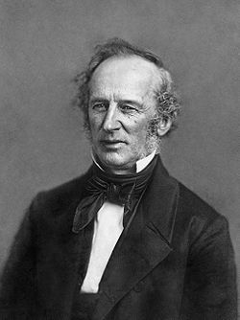
Capitalism continued
Entrepreneur, a person who starts a new business.
Examples of famous entrepreneurs
Andrew Carnegie
John D. Rockefeller
Cornelius Vanderbilt

Slide 8
Socialism
The factors of production are owned by the public and operate for the welfare of all distributing the wealth evenly.

Slide 9
You have two cows

Slide 10
Socialism
SOCIALISM: You have two cows. The government takes one of them and gives it to your poor neighbor.

Slide 11
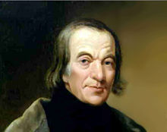
Socialism continued
Robert Owen: built a utopia society in Lanark Scotland and later in America in New Harmony, Indiana.

Slide 12
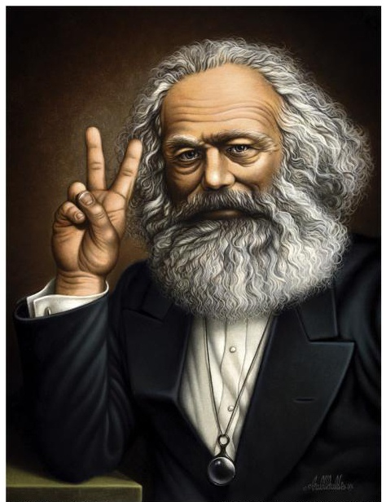
Socialism continued
Karl Marx: Believed socialism would help make the world a better place but because of the greed of the rich capitalists, the workers of the world would have to unite and take control of government.

Slide 13
The Communist Manifesto
Wrote by Friedrich Engels and Karl Marx
Said that human societies are divided into two warring classes
Haves = bourgeoisie (Upper and Middle Class)
Have-Nots = proletariat (working class)
Said workers would rise up and unite overthrowing the factory owners ending capitalism.

Slide 14
Communism
when the government controls the means of all production and in a way is controlled by the people who are said to be in control of the government as a way of having a classless society. This look good on paper but when you give the responsibility and power of running government to a group of people “absolute power corrupts absolutely.”

Slide 15
More Cows

Slide 16
Communism
COMMUNISM: You have two cows. The government takes both of them and gives you part of the milk.
COMMUNISM: You have two cows. The government takes both cows. The government sells the milk in government stores. You can't afford the milk. You wither away.
COMMUNISM: You have two cows. The state takes both, and gives you a little milk ... once.
COMMUNISM: You have two cows. The government takes both and gives you spoiled milk.

Slide 17
Long-term effects on industrialized societies.
Industrialization increases the wealth of a nation
created a middle class
standard of living and material comfort improved for most.

Slide 18
project

