Slide 1
Factories and Workers

Slide 2
Study this picture and write what you see in it.

Slide 3
Study this picture and write what you see in it.

Slide 4
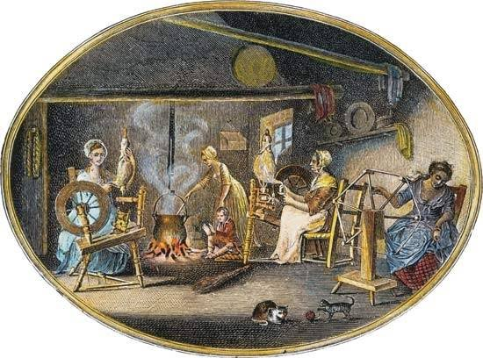
Production Before Factories
Cottage industries, products produced by hand

Slide 6
Advantages and disadvantages for worker of Cottage industries
Advantages
workers controlled their schedule
controlled quality of their product
Disadvantages
a fire or flood could destroy everything
skills took a long time to learn and some equipment required a lot of strength to use.

Slide 7
Activity

Slide 9
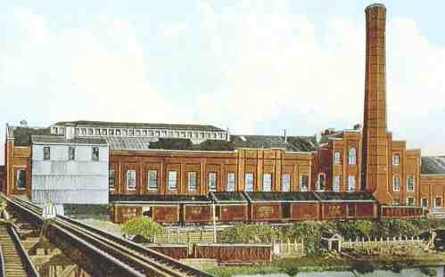
Factory Work
Jobs divided into separate easy tasks
Child workers
Dangerous
Long work days

Slide 10
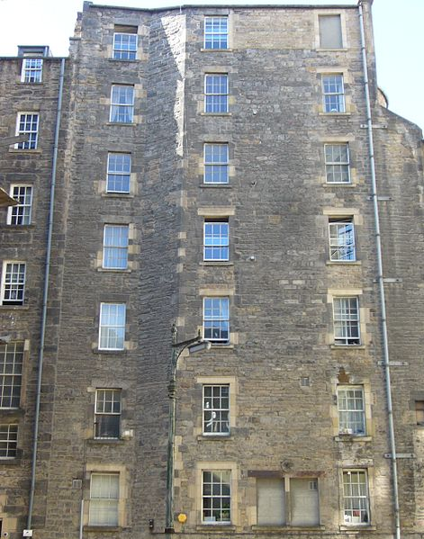
Life in factory towns
Factories first would be built by rivers, and towns began developing around these factories.
Some factories provided housing for its employees in buildings called tenements.
After the use of steam engines, factories and towns began developing around coal mines.
High air pollution from the burning of coal developed in the regions around these towns.

Slide 11
Factory workers
Factories required a large amount of money to build.
3 main levels of factory workers
Factory owners
Mid-level employees like supervisors
Low-level employees to run machines.
product quality declined

Slide 12
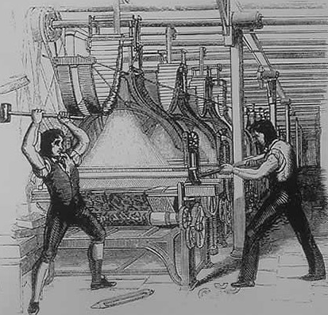
The Luddite Movement
Out of work cottage workers joined together and tried to destroy factories, but the movement ended quickly.

Slide 13
Changes in labor conditions
British Government didn’t get involved in regulating business in the early 1800.
As a result workers formed labor unions.
To improve conditions workers went on strikes.
Eventually the British government passed laws limiting work hours for adults and children.
They also passed laws that child workers had to be at least 9 years old.

Slide 14
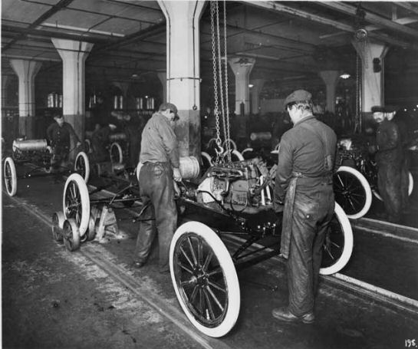
Mass production
Started in the United States
Interchangeable parts
Assembly line
Henry Ford

Slide 15
Positive effects from the Industrial Revolution
Created jobs
Contributed to the wealth of a nation
Items once considered a luxury became affordable for everyone
Better working environments from laws influenced by labor unions
Child labor laws we have today

Slide 16
Review questions
1) what was a Cottage industry?
2) Why was factory work dangerous, especially for children?
3) Why did labor unions form?

