Slide 1
Guiding Students Through a DBQ

Slide 2
Step #1
Read the directions
Read the task/prompt….more than once!!!
What are you being asked to do?

Slide 3
Step #2
On notebook paper brainstorm all of the information you already know about the topic.
Events
People
Places
Time Period
Inventions

Slide 4
Step #3
Read the documents and answer the questions that accompany the documents.
How do the documents match your brainstorm list?
Do the documents remind you of facts to add to your brainstorm list?

Slide 5
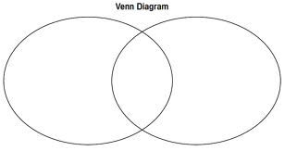
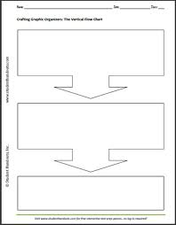
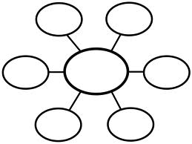
Step #4
Organize your facts and the documents
You could use a graphic organizer

Slide 6
Step #5
Write your thesis statement and introductory paragraph.
What is your answer? Get to the point!!!
Do you have subtopics?

Slide 7
Step #6
Write the body of your answer.
Have a paragraph about each of your subtopics.
Provide evidence, proof, examples
Here is where you use the documents

Slide 8
Step #7
Write your conclusion
Bring it all together
How do your subtopics answer the prompt?
Do NOT introduce new information

Slide 9
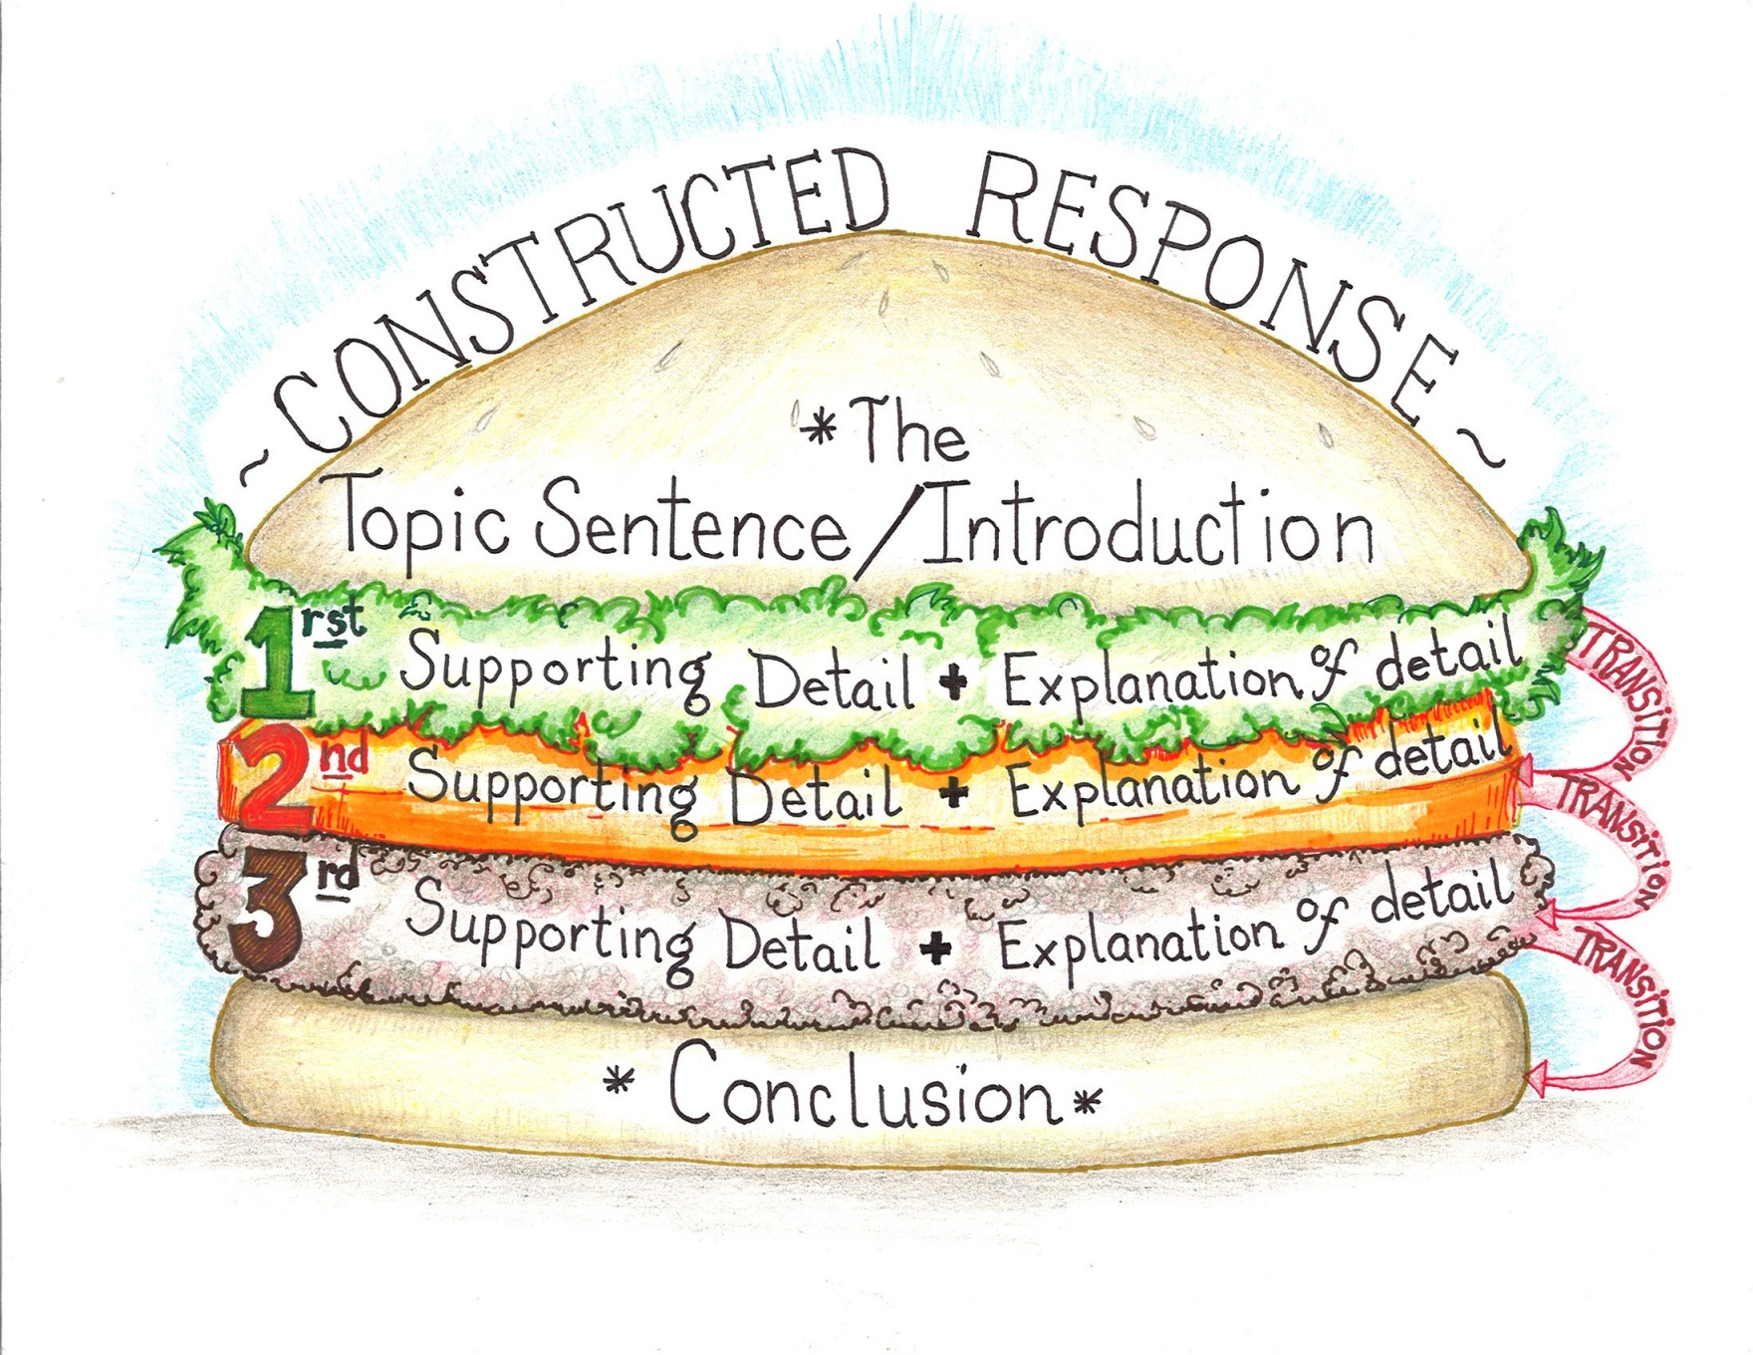

Slide 10
Possible Transition Terms
However
Therefore, Thus
First, Second, Third
Likewise, Similarly
In contrast, Nevertheless
As a result
In conclusion

Slide 11
To Help w/ Subtopics
P = political
E = economic
R = religion
S = social
I = invention/technology
A = artistic

Slide 12
Could be used throughout the year to analyze documents
S = subject What is being discussed?
O = occasion What is the context of the event?
A = audience To whom is the message directed?
P = purpose What is the recommended action
S = speaker Who/what is the source?

Slide 13
Could be used throughout the year to analyze documents
A = author
P = place and time
P = prior knowledge
A = audience
R = reason why
T = the main idea
S = significance

