Slide 1
Dawn of the Industrial Age In Britain
Chapter 19 Section 1 and 2

Slide 2
Life before Technology
For thousands of years, most people lived in farming villages
In the 1700’s changes began to occur that would effect the lives of everyone
This period is known as the Industrial Revolution
A long, slow, uneven process when people shifted from using simple hand tools to complex machines

Slide 3
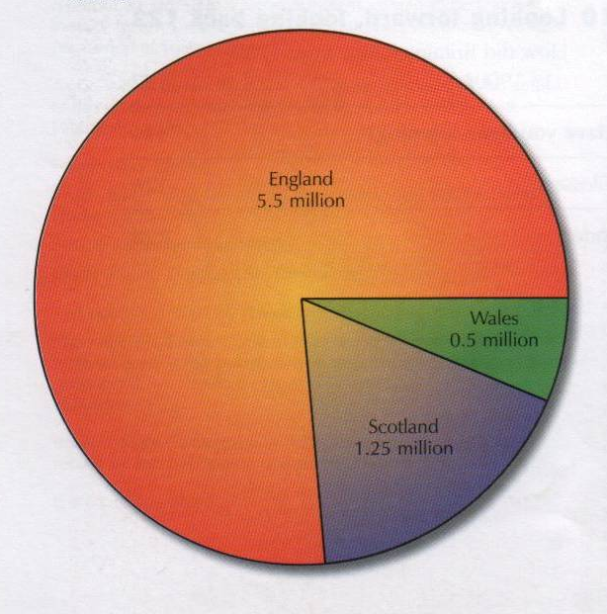
How many people were there?
How do historians know how many people lived in Britain in 1750?

Slide 4
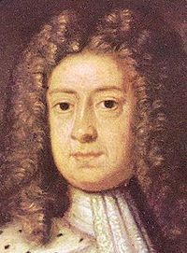
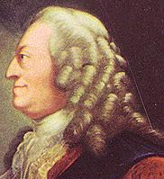
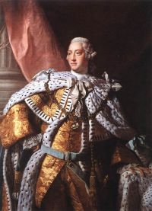
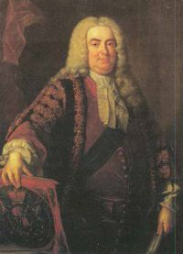
Who ruled?
1714-27 George I – German-speaker fabled for his lovers!
1727-1760 George II – preferred Germany, last King to fight in battle
1760-1820 George III – English speaker, occupied Buckingham Palace, farmer George
Walpole

Slide 5
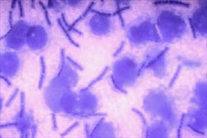
How healthy were people?
Medicine & hygiene very primitive
Killer diseases – pneumonia, bronchitis, diphtheria, tuberculosis, cholera & smallpox
Average life expectancy 30 yrs
15 in every 100 children died before 1st birthday
1 in 5 mothers died
Bacteria

Slide 6
How did people get around?
‘We set out at six in the morning and didn’t get out of the carriages (except when we overturned or got stuck in the mud) for 14 hours. We had nothing to eat and passed through some of the worst roads I ever saw in my life’
This is a description of a journey by Queen Anne in 1704 from Windsor to Petworth – a journey of 40 miles. What does it tell us about transport at the time?

Slide 7
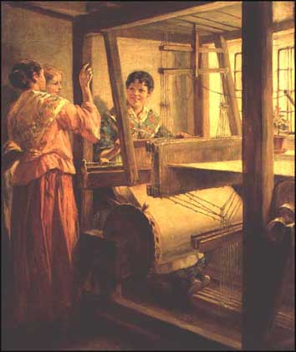
How did people make money?
8 out of 10 worked in countryside
Subsistence farming
Cottage industries - factories rarely employed more than 50 people
Handmade – buttons, needles, cloth, bricks, pottery, bread etc.
Developing towns – Liverpool,
Birmingham, Glasgow
Welsh spinsters
How many objects do you have about you or can you see in the room that are handmade?

Slide 8
Life Changes
In 1750, most people worked using handmade tools, living in simple homes lit by candles. Many people made their own clothes/grew their own food.
By the 1850’s people began to change their lifestyles to move to larger cities to work in factories etc.
In these towns, people were able to easily buy goods produced by other people.

Slide 9
 | 1750 | 1830 | 1890
Power / energy
Population density
Transport
Work / jobs

Slide 10
 | 1750 | 1830 | 1890
Power / energy | Wind Water | Steam Wind | Steam Electricity
Population density | Low | Medium | High
Transport | Road Horse Sail | Railway Canal Sail | Railway Tram Bicycle Steamship
Work / jobs | Farming Mining | Farming Mining Factory | Factory Shops Transport Library

Slide 11
New Inventions
The Telegraph
http://library.thinkquest.org/5493/morsecode.htm
http://www.youtube.com/watch?v=7Z8yzyKs7GI
(Leno Vid)
http://www.dailymotion.com/mychannel/INDIVO/video/x6n4zk_fastest-morse-code-sent-and-receive_tech
The Steam Engine
http://revver.com/video/422187/another-victorian-steam-engine-model/
http://revver.com/video/422195/big-stationary-steam-engine/

Slide 12
Mechanization
During the first half of the 19th century, the European manufacturing process shifted from small-scale production by hand at home to large-scale production by machine in a factory setting.

Slide 13
At the Expense of Workers
The shift meant high quality products at competitive prices, but often at the expense of workers. For example, the raw wool and cotton that fed the British textile mills came from:
Lands converted from farming to sheep raising, leaving farm workers without jobs

Slide 14
Urban Growth
Those who could no longer make a living on the land migrated from the countryside to the cities to seek work in the factories.
1850: Population Living in Cities

Slide 15
Population Growth
At the same time, the population of Europe continued to grow.

Slide 16
The Plight of the Cities
The sheer number of human beings put pressure on city resources:
Housing, water, sewers, food supplies, and lighting were completely inadequate.
Slums grew and disease, especially cholera, ravaged the population.
Crime increased and became a way of life for those who could make a living in no other way.

Slide 17
Conditions in the Countryside
The only successful farmers were those with large landholdings who could afford agricultural innovations.
Most peasants:
Didn’t have enough land to support themselves
Were devastated by poor harvests (e.g., the Irish Potato Famine of 1845-47)
Were forced to move to the cities to find work in the factories.

Slide 18
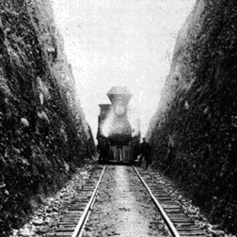
The Role of the Railroads
The railroads, built during the 1830s and 1840s:
Enabled people to leave the place of their birth and migrate easily to the cities.
Allowed cheaper and more rapid transport of raw materials and finished products.
Created an increased demand for iron and steel and a skilled labor force.

Slide 19
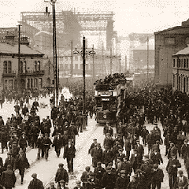
The Labor Force
No single description could include all of these 19th century workers:
Factory workers
Urban artisans
Domestic system craftsmen
Household servants
Miners
Countryside peddlers
Farm workers
Railroad workers
Variations in duties, income, and working conditions made it difficult for them to unite.

Slide 20
The Condition of Labor
All working people, however, faced possible unemployment, with little or no provision for security.
In addition, they were subject to various kinds of discipline:
The closing of factory gates to late workers
Fines for tardiness
Dismissal for drunkenness
Public censure for poor quality workmanship
Beatings for non-submissiveness

Slide 21
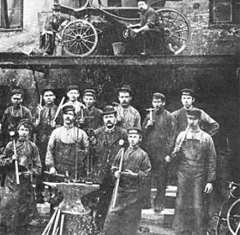
Prolitarianization
During the century, factory workers underwent a process of proletarianization (i.e., they lost control of the means of production).
Factory owners provided the financial capital to construct the factory, to purchase the machinery, and to secure the raw materials.
The factory workers merely exchanged their labor for wages.

Slide 22
Family Structures Changed
With the decline of the domestic system and the rise of the factory system, family life changed.
At first, the entire family, including the children, worked in the factory, just as they had at home.
Later, family life became fragmented (the father worked in the factory, the mother handled domestic chores, the children went to school).

Slide 23
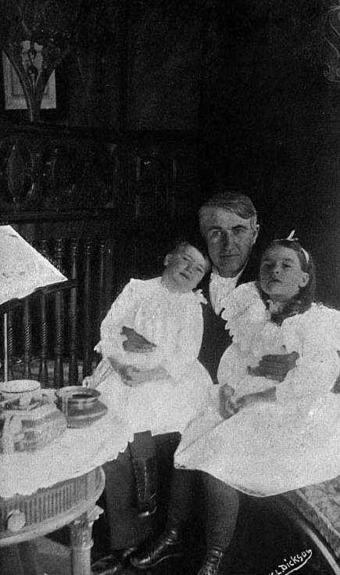
Family as a Unit of Consumption
In short, the European family changed from being a unit of production and consumption to being a unit of consumption alone.

Slide 24
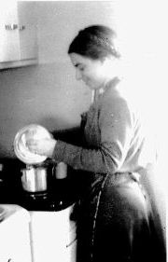
Gender-Determined Roles
That transformation prepared the way for gender-determined roles.
Women came to be associated with domestic duties, such as housekeeping, food preparation, child rearing and nurturing, and household management.
The man came to be associated almost exclusively with breadwinning.

