Slide 1
Rationing
You “buy” with ca$h money and/BUT you must ALSO have “the points;” the stamps, to buy.

Slide 2


Slide 3
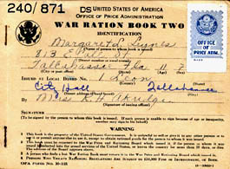
Ration Points
Each Person gets 16 points a week
Canned goods (blue stamps) 48 points a month
Wheatless Mondays
Meatless Tuesdays

Slide 4
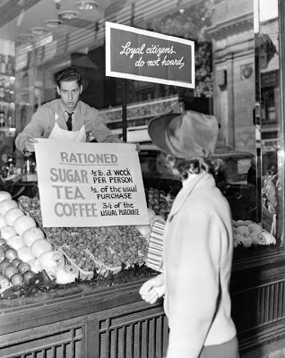
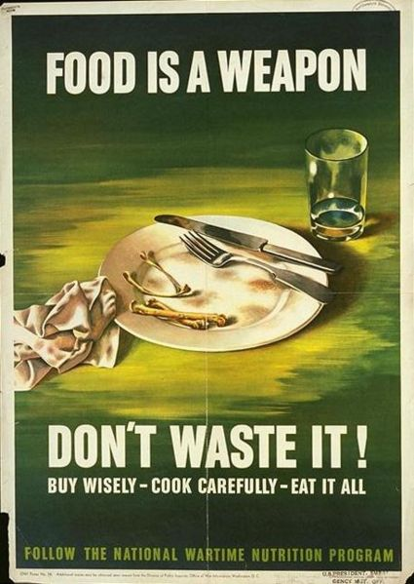

Slide 5
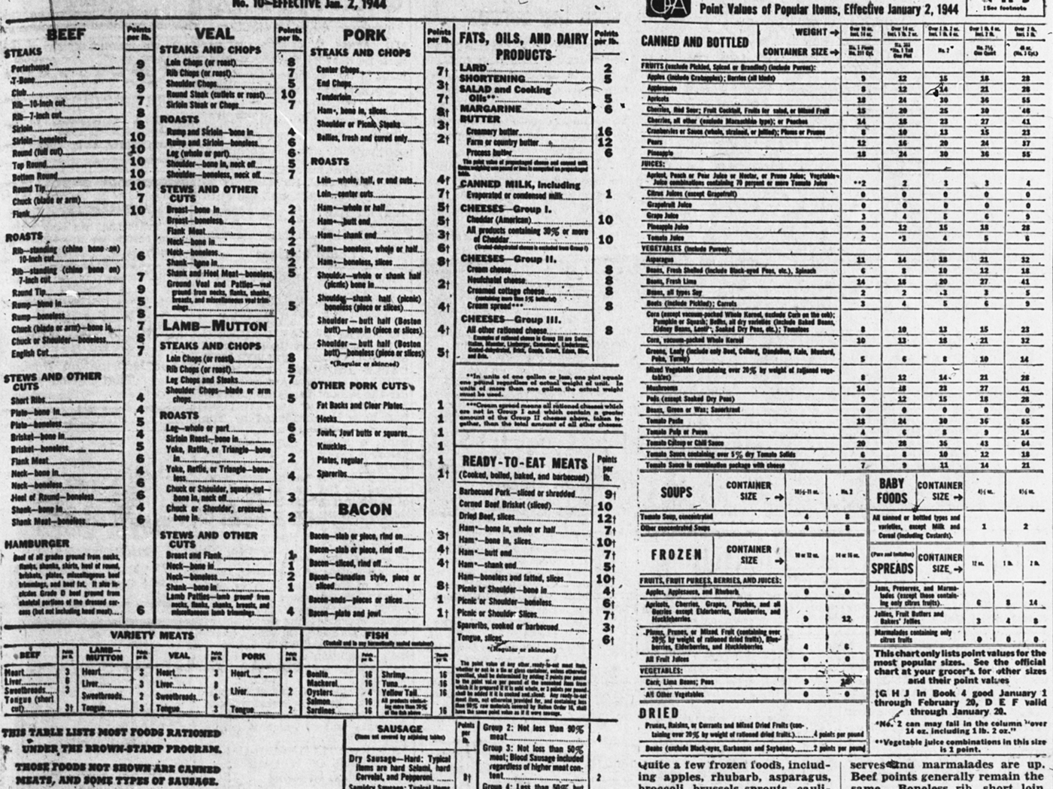
Each person gets 16 points a week

Slide 6
Homefront WW II typed copy of a hand written letter
Dear Pete,
Received your letter and am hurrying to answer it. Pretty soon weeks pass by.
I don’t know which is worse – too dry weather or too wet weather such as we are having here at present. Our back yard is a regular lake. Instead of a victory garden we should have planted rice.
You are lucky to be getting all that food. From what we hear even the camps are skimping on their food. And we—when we go to the store we never say what does that cost but “How many points is that?” Each person gets 16 points a week for meat, cheese, butter, lard and (canned fishes and milk.) Butter is 8 points a pound, lard 5, pork chops 9, steak 11, then neck bones & pigs feet 1,liver 5, cans milk 1, so we have to do some figuring to get enough to eat. The more in the family the easier it is to shop as every member from baby up gets his 16 pts. And babies don’t eat much.

Slide 7
We also have blue stamps 48 pts. a month for canned goods and beans. So Sat. I bought a can of fruit salad 25 pts and a can of pineapple 23 pts. so I can’t have anything more now till next month on my book. But then it keeps our minds alert – counting points.
Chicken and fresh fish is not rationed but they are hard to get, you wait in line for from ½ hr. to 2 hrs, or maybe more for meat; two hrs. for chickens and then if you want them to kill & clean them you come back the next day and wait another 2 hrs to get it.
Also used to be blocks long lines of liquor buyers. But now we’re rationed to 1 qt. a month and you have to buy it yourself. No one else can buy on your ration card.
Then we have a black market too. They charge what they like for potatoes or meat.

Slide 8
The potato situation is better now but for a while you couldn’t buy any potatoes at all Who ever would have thought that the good old U.S.A. would have such conditions to contend with.
Here’s hoping everything is fine with you.
Write when you can.
E. Fett

Slide 9
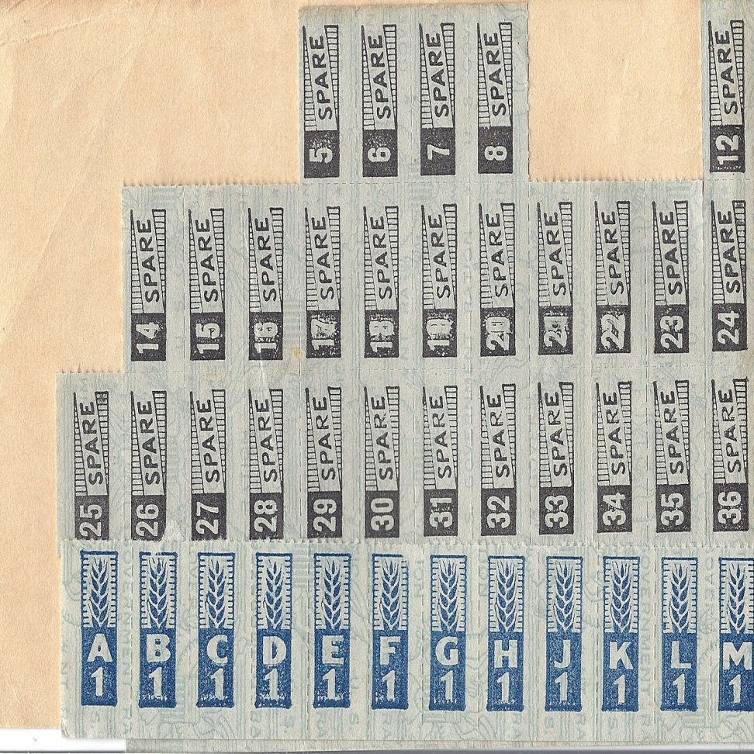
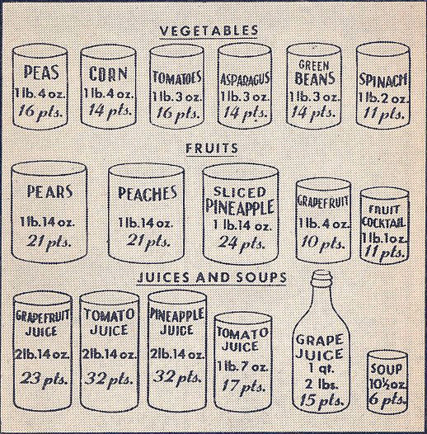
Canned goods, (blue stamps)
48 points an month

Slide 10
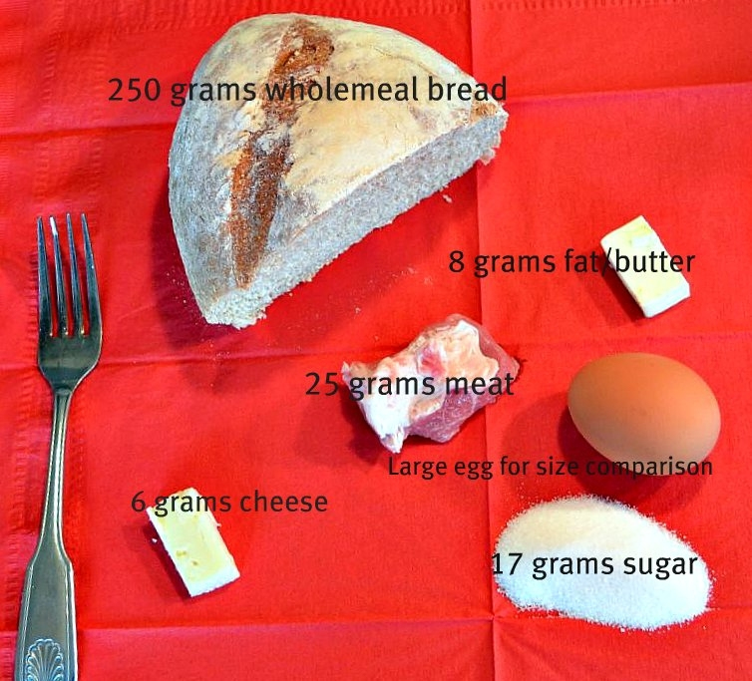
1 day ration

Slide 11
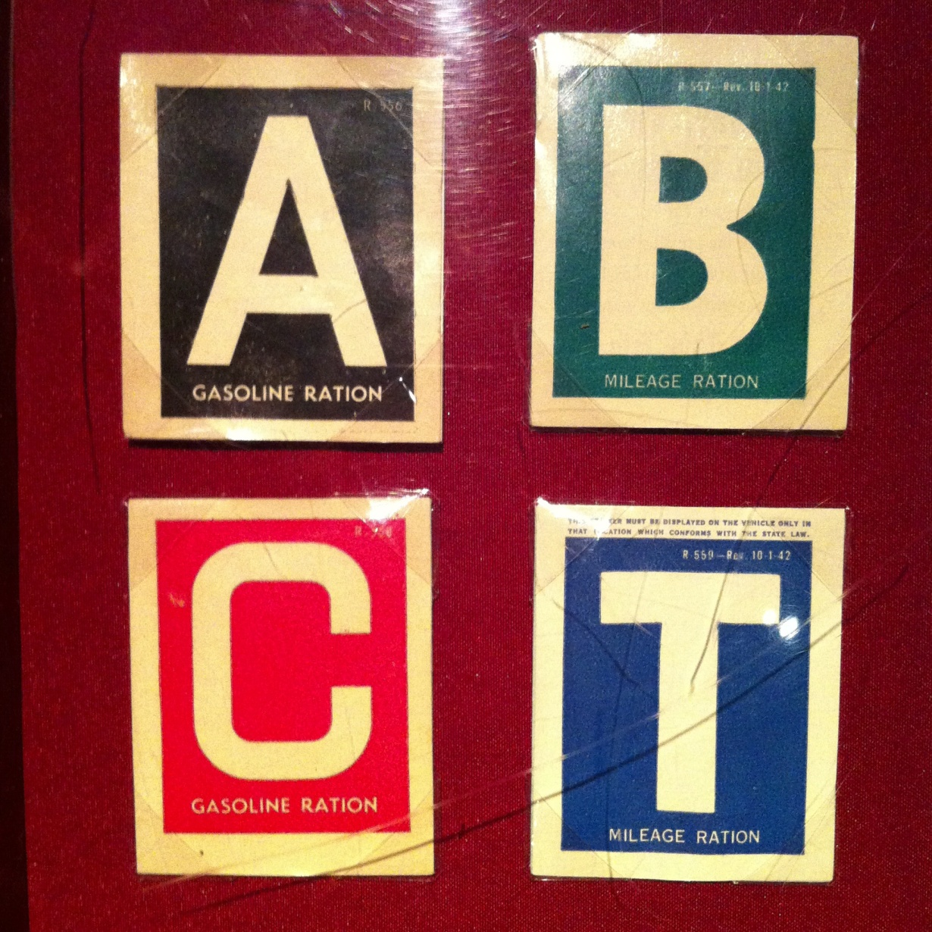
Gasoline rationing
A = nonessential;
B= work use –a salesman
C = essential –doctors, civil defense
T = long distance trucks
Most vehicles were grades A which meant that you got 3 gallons gasonine per week

Slide 12

Other items that were rationed
Rubber
Fuel oil
Cloth
Typewriters
Cars
Bicycles
Stoves
Shoes

Slide 13



