Slide 1
The Second Industrial Revolution
Chapter 14
Section 1 & 2

Slide 2
Sec. 1 Industry and Railroads
Main Idea—During the late 1800’s new technology led to rapid industrial growth and the Expansion of railroads.

Slide 3
NEW INDUSTRIES EMERGE
Electricity—replaced steam and water power.
Enabled factories to become larger.
Bessemer process—allowed steel to be made from iron.
Helped to make taller buildings and bigger bridges.
Oil—refined into kerosene fueled lamps.
Oil boom started in Texas.
Oil and oil products became a major source of energy.

Slide 4
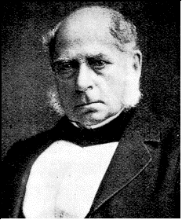
Henry Bessemer

Slide 5
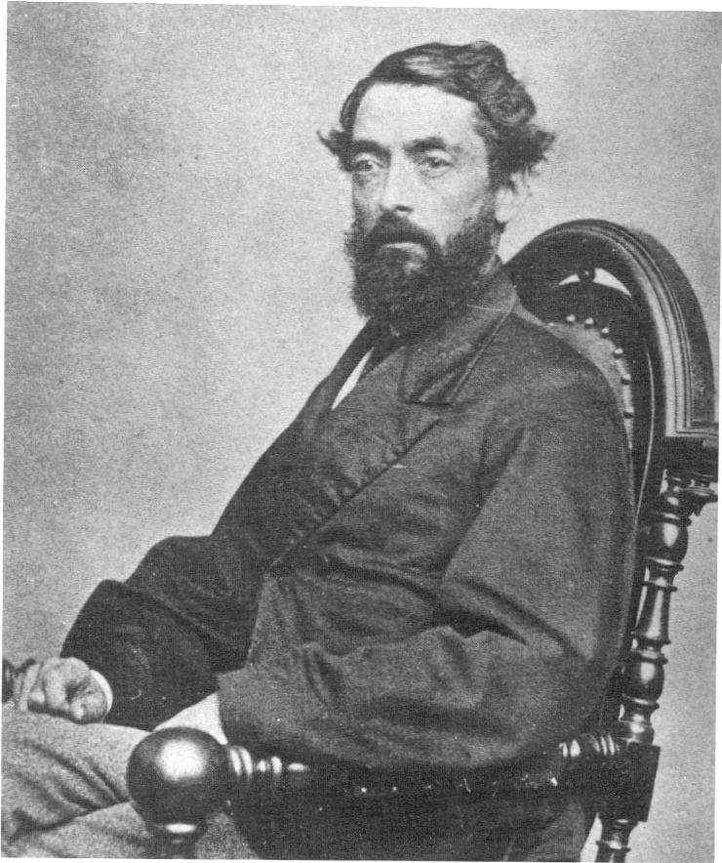
Edwin L. Drake
Edwin L. Drake
Was hired to extract oil from the ground in Pennsylvania
People made fun of him = “Drake’s Folly”
August 1859 he struck oil
Wildcatters or oil prospectors stared searching everywhere for oil
January 1901 at Spindletop Hill near Beaumont, Texas the first major well was struck, this started the Texas Oil Boom.

Slide 6
RAILROADS EXPAND
How did the railroad companies use the land they were given by the federal government?
Federal Government helped by giving thousands of acres of land to the Railroad companies.
Cheap steel also helped railroads grow.
May 10,1869, the first transcontinental railroad was completed.
Used some for new routes; sold some to finance construction.
Why was construction of the Central Pacific railroad more difficult than construction of the Union Pacific Railroad?
The terrain was tougher; crews had to cross deserts, blast through mountains, face attacks by Native Americans.

Slide 7
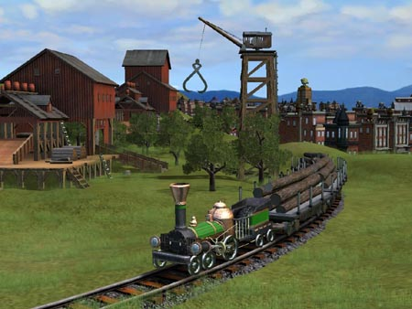
RAILROADS EXPAND
Railroads helped the economy grow.
Made trade easier
Provided jobs
Steel industry growth
Train manufacturers grew
Brought settlers west
Cut journey times down
New towns sprung up
Railroads helped to setup standard time.

Slide 8
Sec. 2 The Rise of Big Business
Main Idea—Corporations run by powerful business leader became a dominant force in the American economy.

Slide 9
A FAVORABLE CLIMATE FOR BUSINESS
Why did business leaders oppose government regulation?
Late 1800’s many people believed that hard work would make them successful.
Capitalism- an economic system in which private businesses run most industries (Ran by entrepreneurs)
Competition determines prices and wages.
Most people believed in Laissez-faire capitalism. (Hands Free)
Thought it would destroy self-reliance, reduce profits, harm the economy.

Slide 10
Social Darwinsim
Americans understood there were inequalities under capitalism.
Many believed this was the natural order
To explain why some people prospered and others did not business leaders embraced this idea of Social Darwinism
Social Darwinists believed that natural selection also applied to society.

Slide 11
BUSINESS STUCTURES CHANGE
At the end of the civil war most businesses were proprietorships (run by individual owners) or partnerships (run two or more people)
Owners were personally responsible for all debts and obligations of business.
In the late 1800’s large businesses began organizing corporations.
A business with the legal status of an individual
Stockholder owned
Own stocks or shares of the company
Decisions are made by the board of directors
Monopolies formed.

Slide 12
Trusts and Monopolies
Trusts companies agreed to merge and turn over their separate stocks to a board of trustees.
Trustees then ran the group of companies as if it were a single corporation, all participants split the profits.
Monopoly= when a trust gains complete control over an industry.

Slide 13
John D. Rockefeller
Starting with an oil refinery and superb business sense, John D. Rockefeller used both vertical and horizontal integration to capture 90 percent of the U.S. oil refinery business by 1879.
Vertical integration- acquiring companies that supplied business. Rockefeller bought barrel factories, oil fields, oil-storage facilities, pipelines, and railroad cars. Allowed to keep costs low and profits high
Horizontal integration- taking over other companies producing the same product.
At one point his fortune approached 900 million
Rockefeller gave away over half of his fortune to charity. He donated millions to education and good works through his Rockefeller Foundation.

Slide 14
Andrew Carnegie
Andrew Carnegie rose from immigrant child to steel magnate. He used profits from various business investments to found his own company. By the end of the century the Carnegie Steel Company dominated the U.S. steel industry.
After retiring, Carnegie devoted his time to charity, supporting education and building public libraries.
Believed that wealthy people had a duty toward the rest of society. Gospel of Wealth

Slide 15
Cornelius Vanderbilt
Vanderbilt began investing in railroads during the Civil War. By 1872, he owned the New York Central Railroad. At the height of his career he controlled 4,500 miles of track.
At the Height of his career, he controlled more than 4,500 miles of railroad track. Also invested heavily in steamship lines.
He supported few charities, but gave money to what would come to be Vanderbilt University. He died leaving an estate of $100 million

Slide 16
George Pullman
George Pullman made his fortune designing and building sleeper cars that made long-distance travel more comfortable. He built a town south of Chicago to house workers in relative comfort, believing happy workers were more productive.
The Pullman Company controlled aspects of life in the town, and criticism was not tolerated.

Slide 17
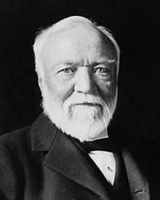
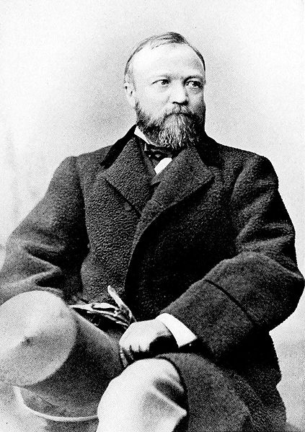
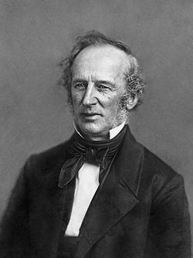
Cornelius Vanderbilt
George Pullman
Andrew Carnegie
John D. Rockefeller

Slide 18
INDUSTRIAL TYCOONS
How did Rockefeller and Carnegie use their wealth to do good?
Both men gave substantial amounts to universities. Carnegie built Public libraries, Carnegie Hall, financed scientific work and international peace efforts.

Slide 19
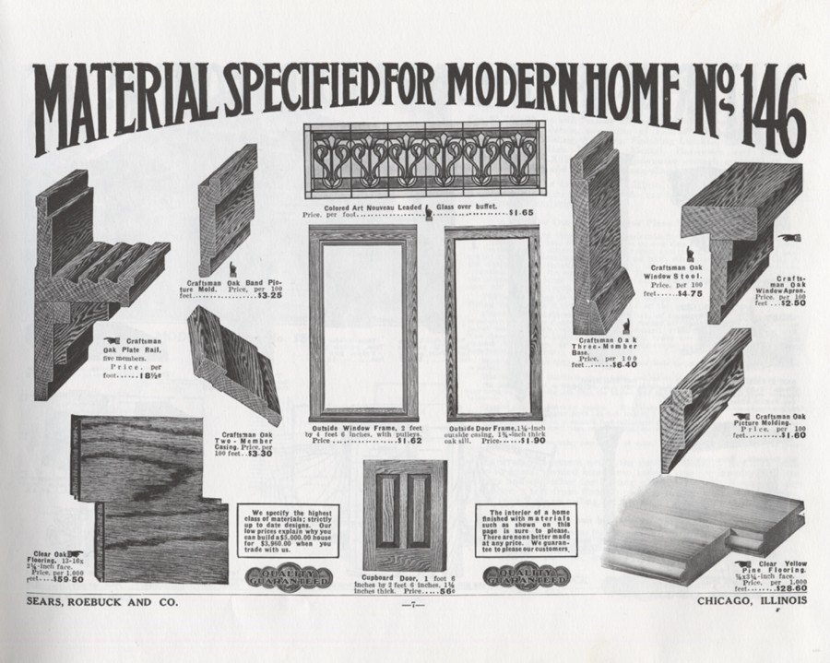
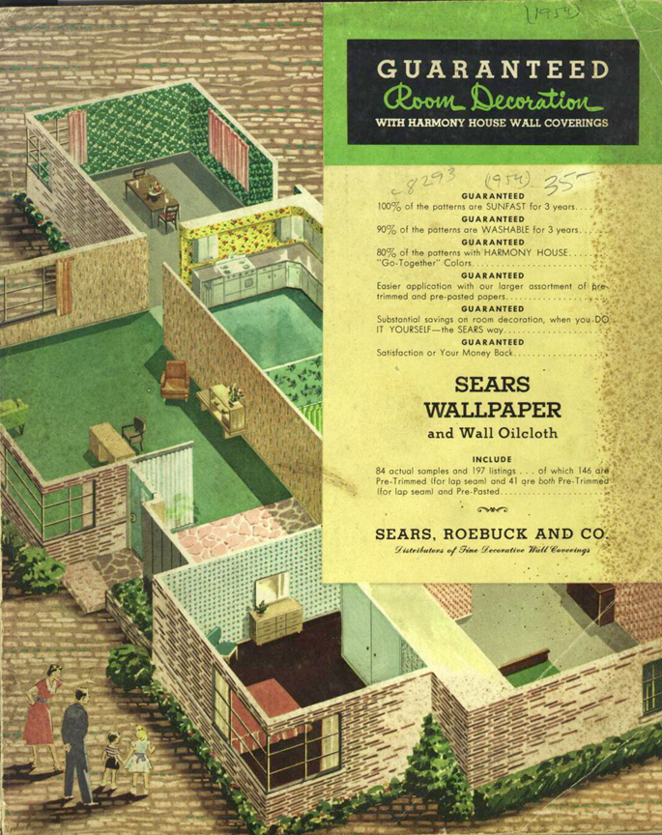
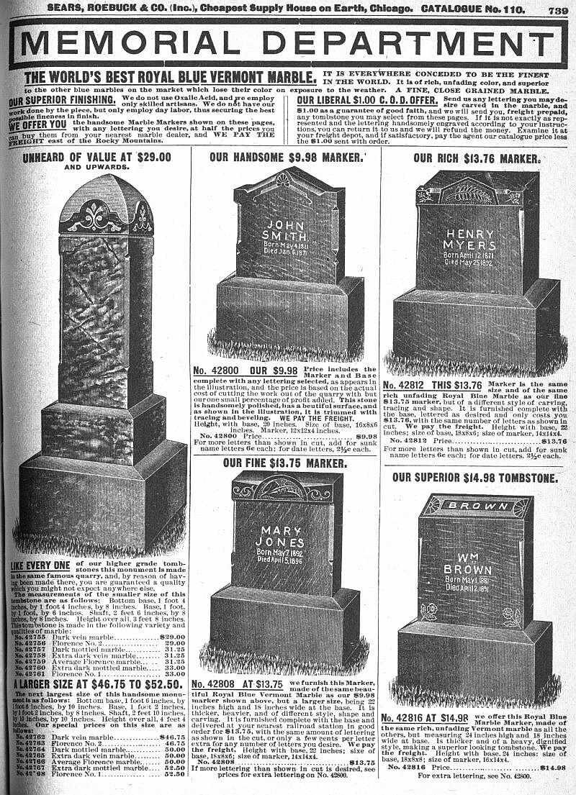
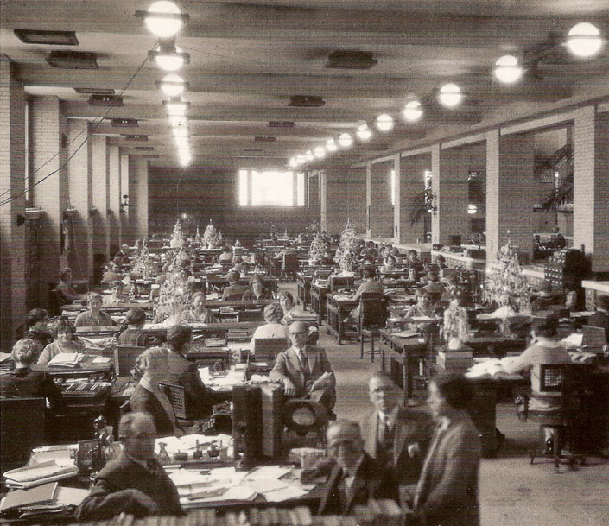
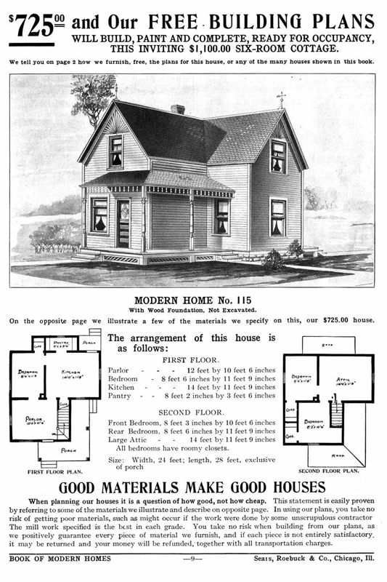
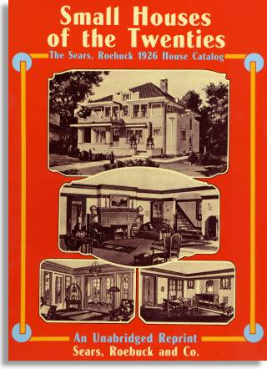
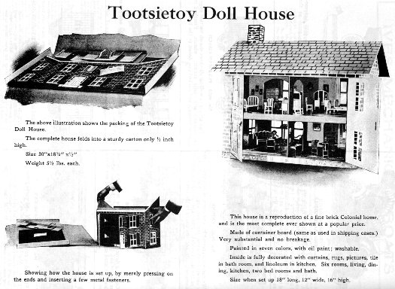
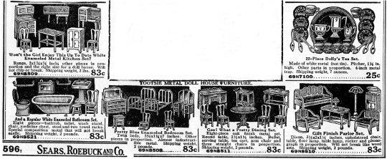
MASS MARKETING
Department stores formed with many products under one roof.
Catalogs—for people who didn’t live close to the store.
Sears, Roebuck
Peoples purchases arrived by mail.

